Slide 1
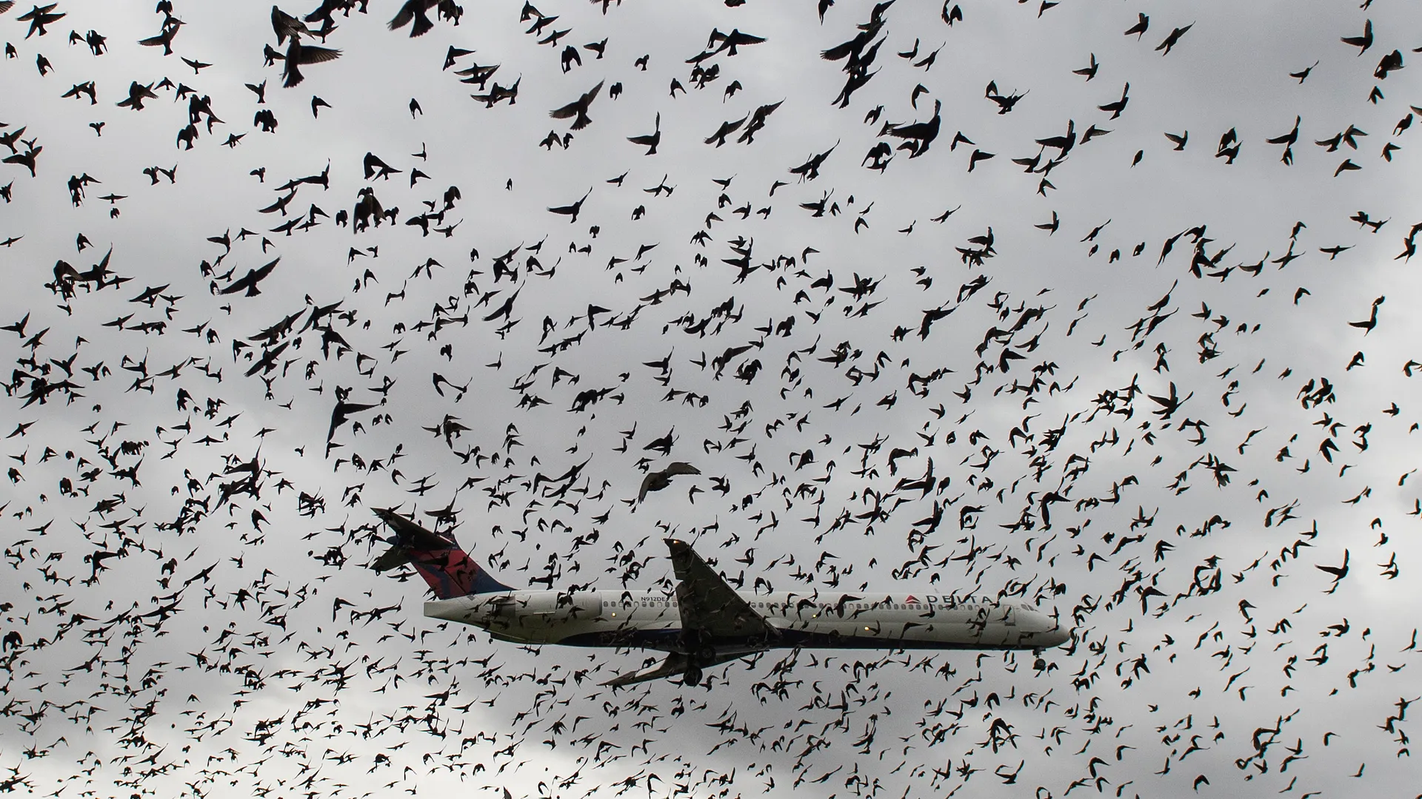
BIRD STRIKES ANALYSIS REPORT
2000 - 2011
-SHAKEEB QURESHI

Slide 2
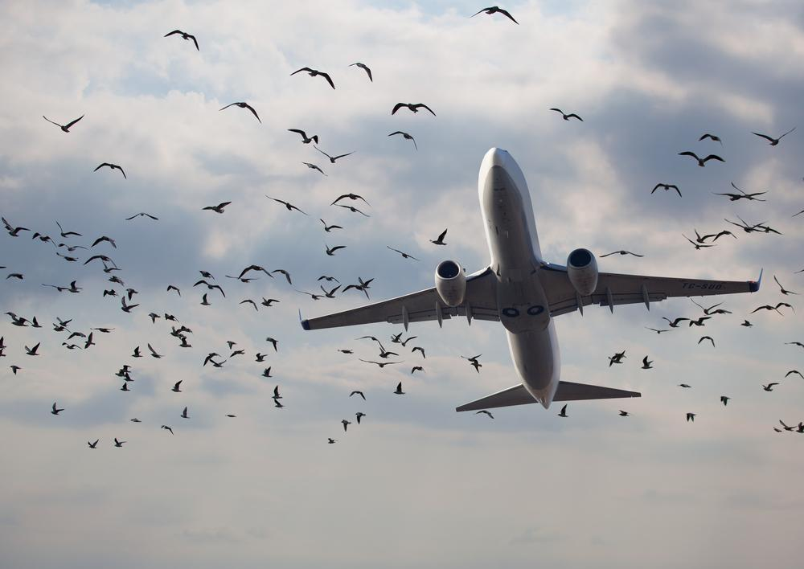
This project includes an illustrative analysis on Bird Strikes between the years 2000 and 2011, and analysis attributes like Bird Strike occurrences, costs, and impacts across airlines, airports, and flight phases for aviation safety insights.
This project is performed using Tableau, and utilizes comprehensive data to identify patterns and trends in bird strikes, providing valuable information for mitigating future incidents.
PROJECT OVERVIEW

Slide 3
BIRD STRIKE OCCURRENCES BY YEAR
AIRLINE - SPECIFIC BIRD STRIKE DATA
BIRD STRIKES BY AIRPORT
ALTITUDE AT TIME OF BIRD STRIKE
CLIMATE CONDITIONS DURING BIRD STRIKES
PILOT INFORMATION AND AWARENESS
FLIGHT PHASE DURING BIRD STRIKE
COST INCURRED DUE TO BIRD STRIKES
IMPACT ON FLIGHT OPERATIONS
REPORT OUTLINE

Slide 4







MAJOR METRICS
NUMBER OF BIRD STRIKES
NO. OF PEOPLE INJURED
TOTAL COST INCURRED
25,429
27
$ 142.3 M
AVG. FT. ABOVE GROUND
NO. OF WILDLIFE STRUCK
AIRPORT WITH MAX STRIKES
799
68,790
SOUTH WEST AIRLINES

Slide 5
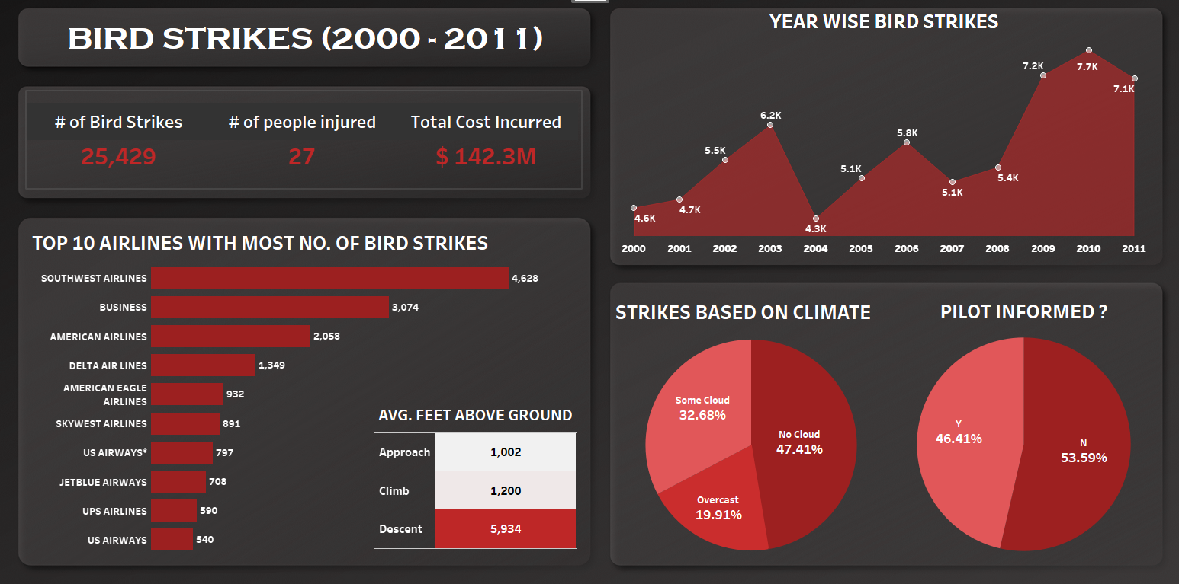
DASHBOARD 01

Slide 6
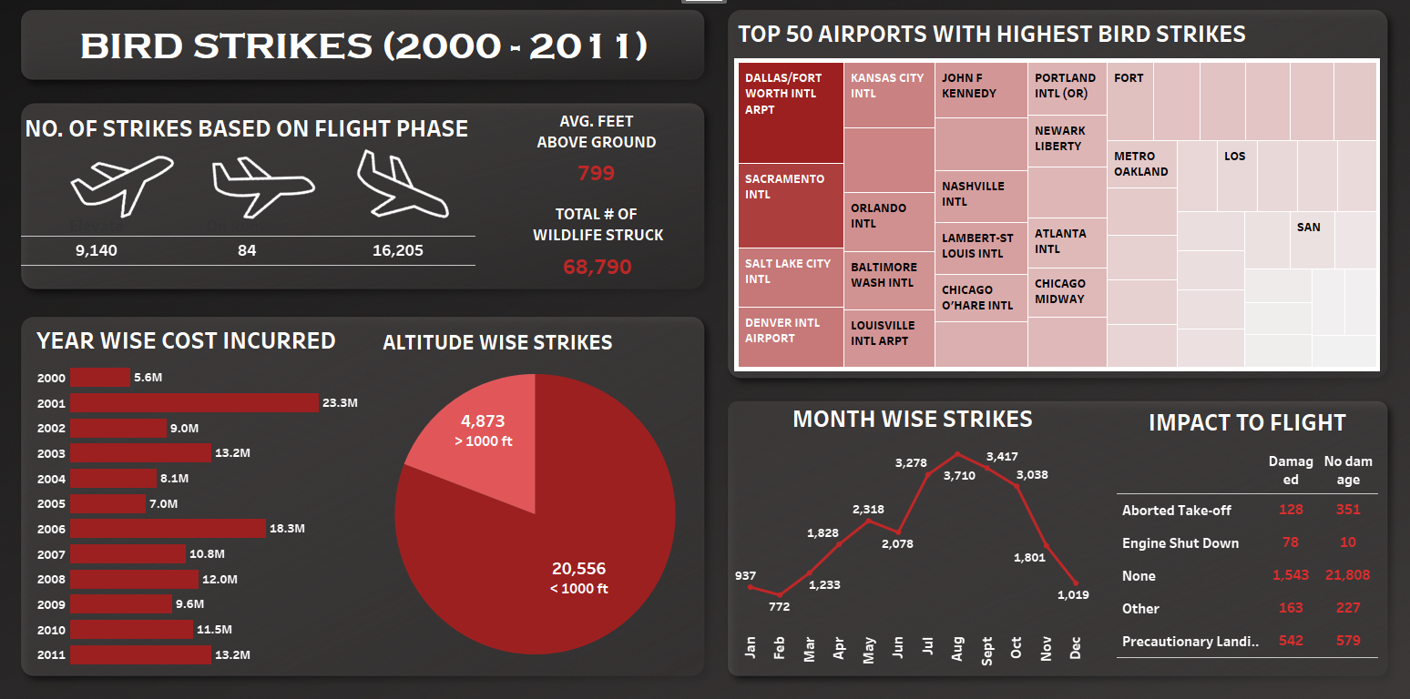
DASHBOARD 02

Slide 7

Thank you!

